Slide 1
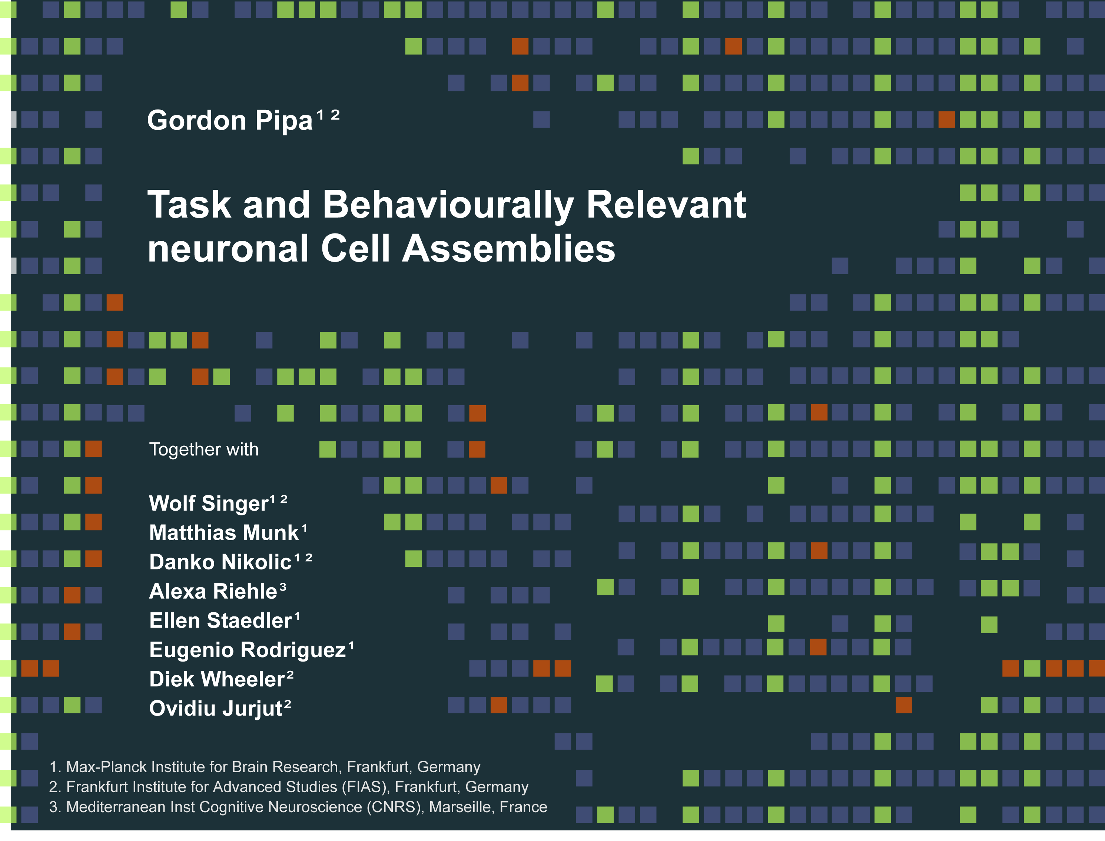
Neuroinformatics Lecture (LX)
Prof. Dr. Gordon Pipa
Institute of Cognitive Science, University of Osnabrück
Notes:
Hallo and thank you for the introduction.
I will present a non-parametric significance test for estimating the statistical significance of Joint-Spike events.

Slide 2
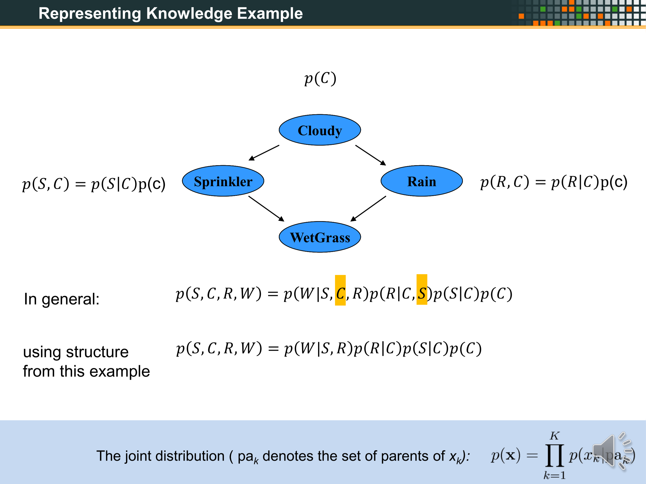
XXX
XXX
OLD

Slide 3
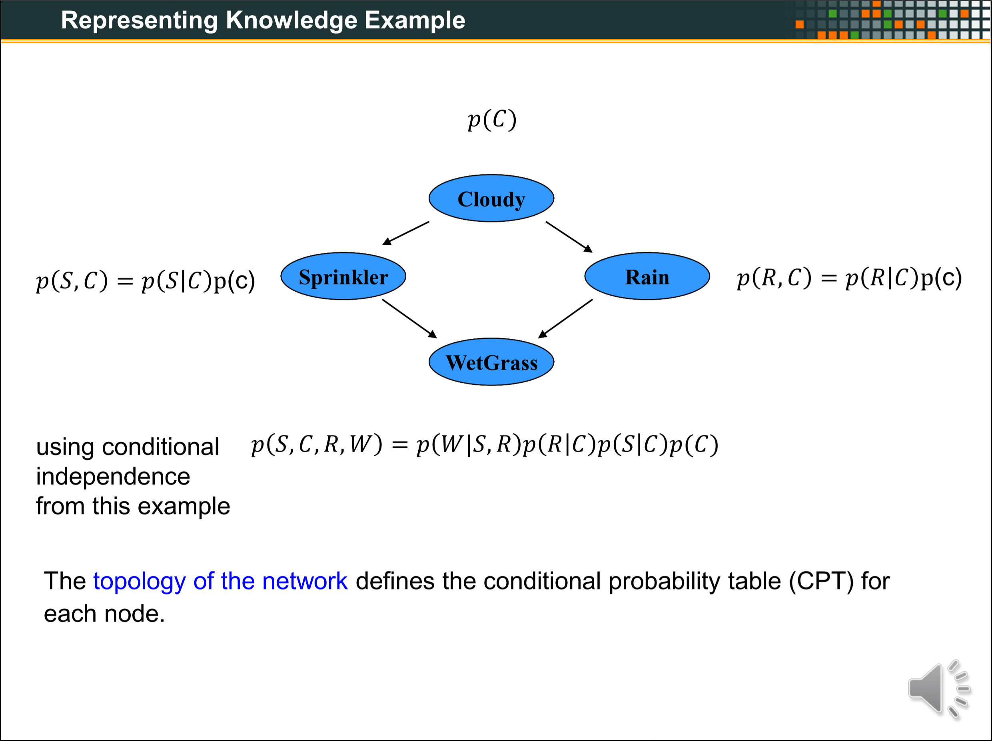
XXX
XXX
OLD

Slide 4
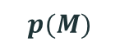

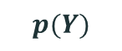

Representing Knowledge Example
How to use graphical models for real world problems?
The model can help us to understand how a special state is dependent on its conditions.
e.g. When do I have information about the content of a
lecture? (Informed)
1. I can visit the lecture (Motivation) and write down notes
(Yourself) by my self.
2. I don’t go to the lecture (Motivation) and you try to get
some notes of your colleague (Someone).
$$p(M)$$
Motivation
$$p(Y)$$
$$p(S)$$
Yourself
Someone
Informed
$$p(I)$$
With knowing the probabilities of the conditions, there is a way to easily compute the probability of the state.
➔ Using conditional probability tables (CPT)

Slide 5
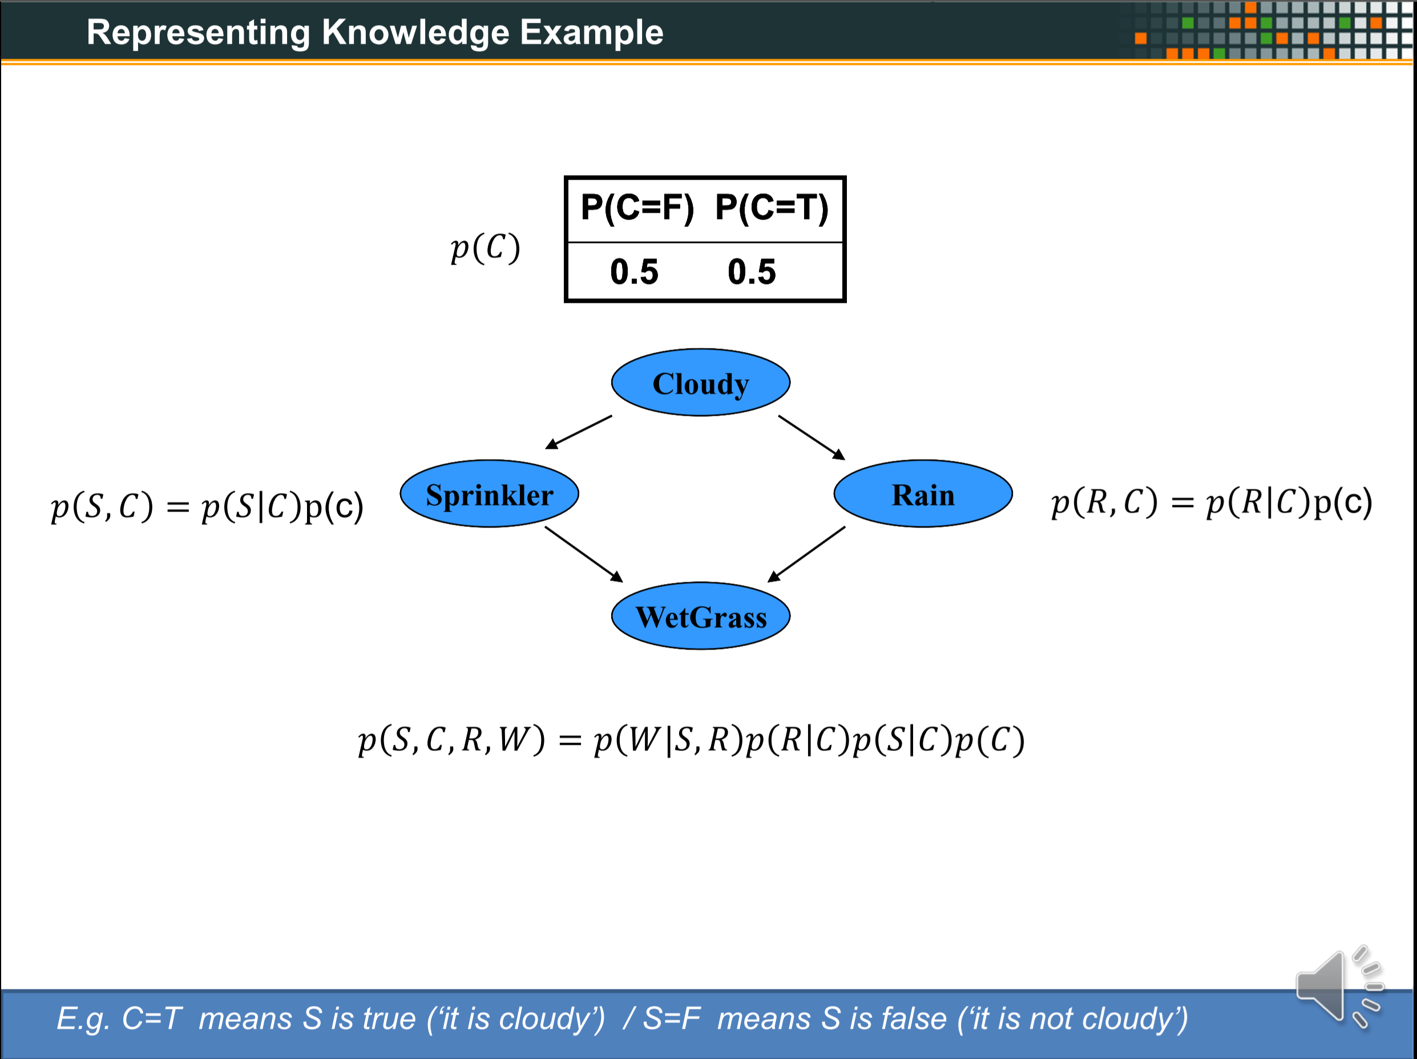
XXX
XXX
OLD

Slide 6
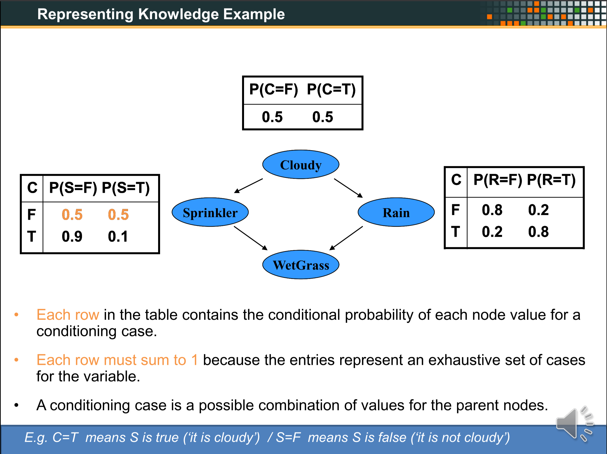
XXX
XXX
OLD

Slide 7
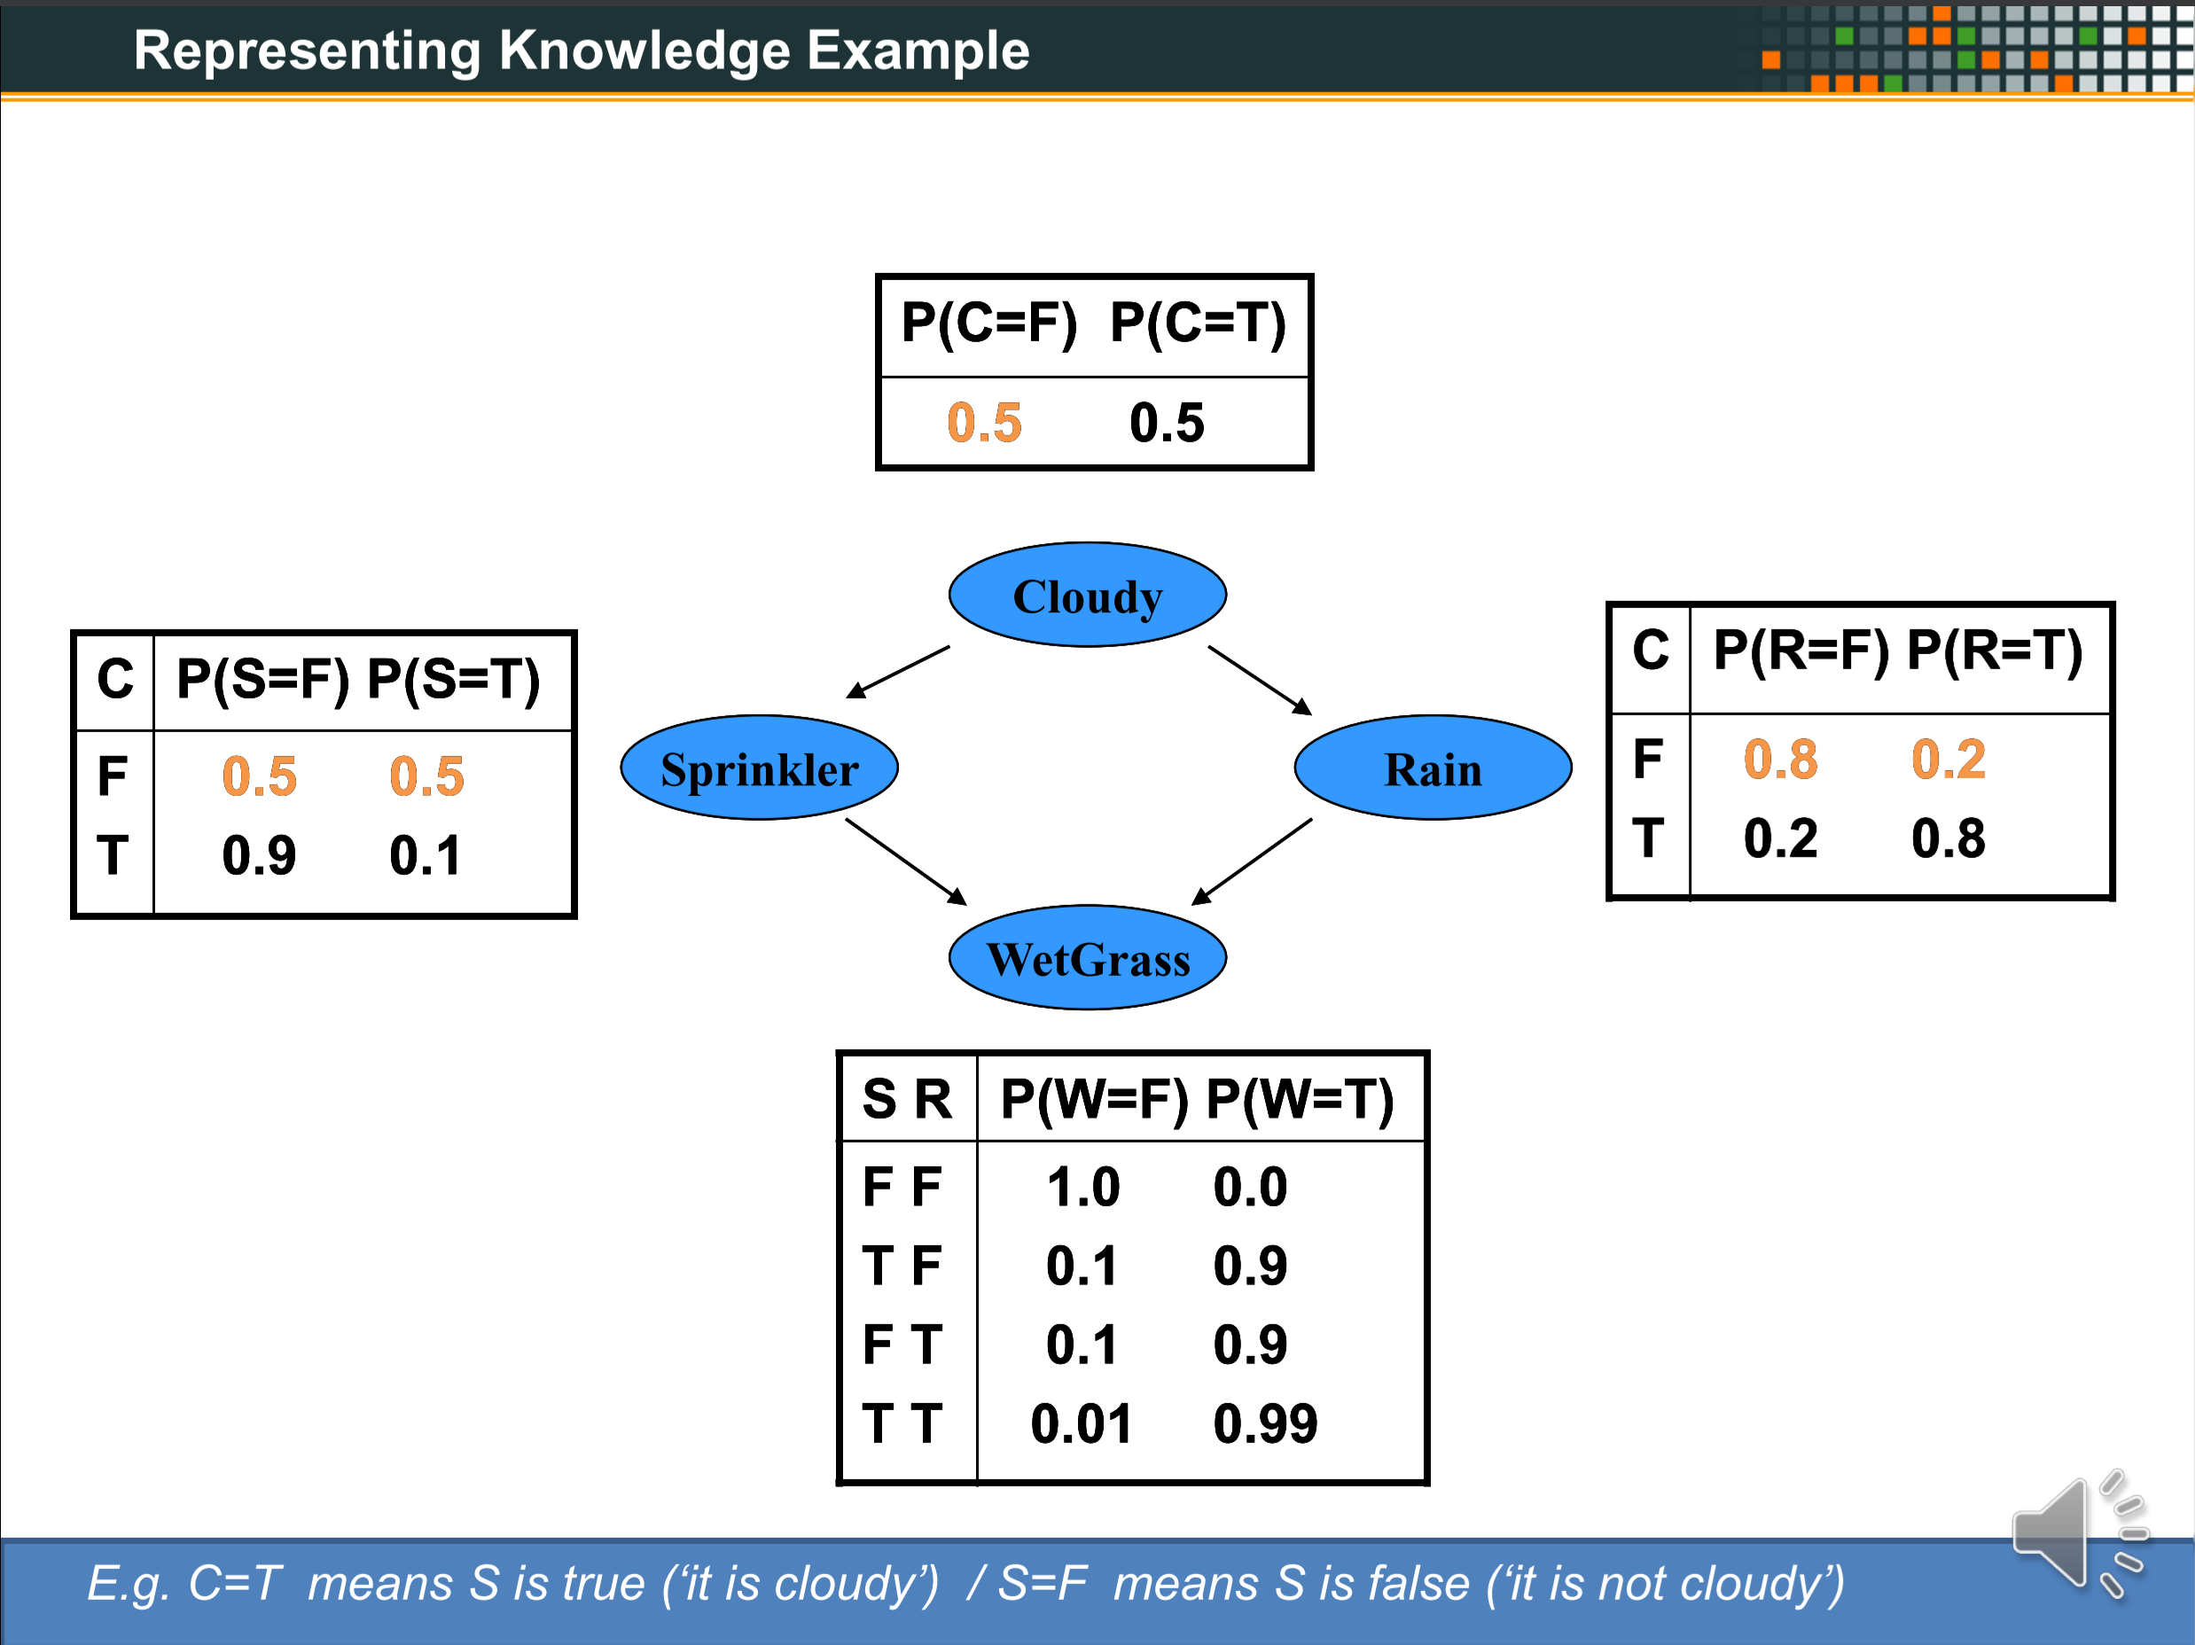
XXX
XXX
OLD

Slide 8
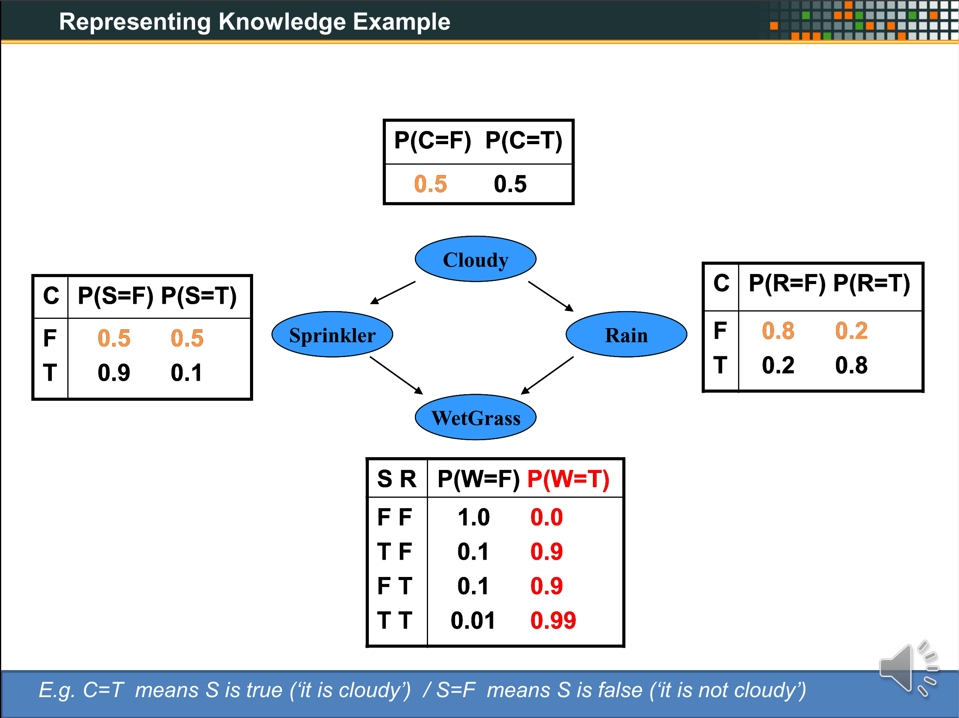
XXX
XXX
OLD

Slide 9
XXX
XXX

Slide 10


Questionnaire
Q
Start
Timer
Stop
freemusicarchive.org/music/Kai_Engel/

Slide 11
Questionnaire
S

